Slide 1
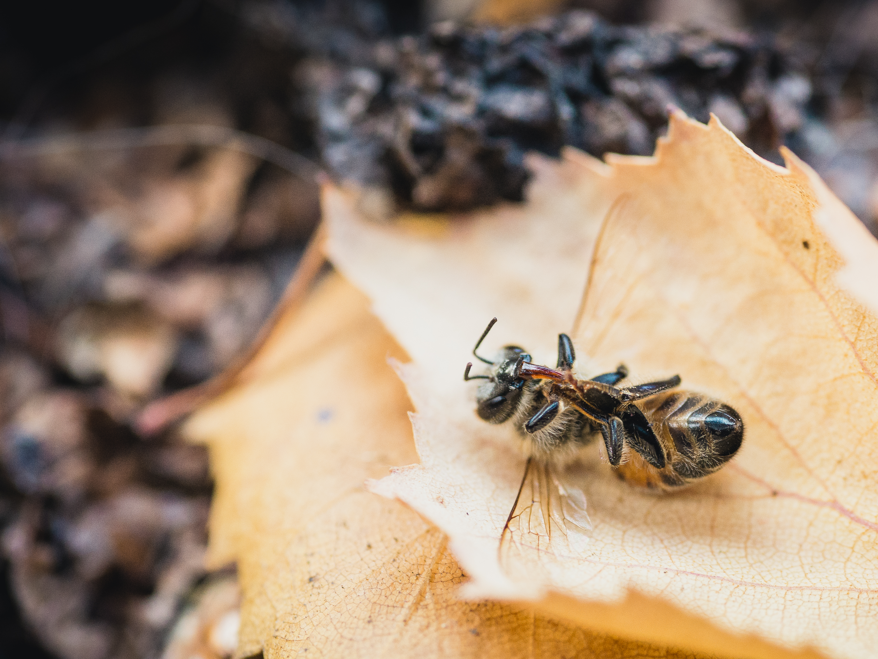
The Problem
Honeybees are sick and are vanishing from hives, never to return.

Slide 2
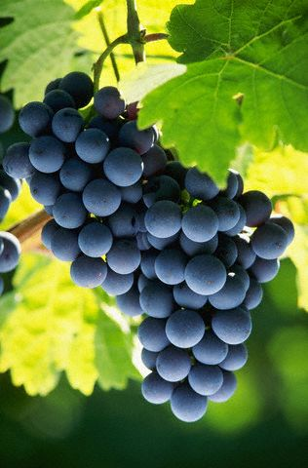
Consequences
Crops pollinated by honeybees are in danger.
1
Human food crop production is heavily dependent on bee pollination.
2
Researchers estimate that 1 of every 3 bites you take needed honeybees to become food.
3
Favorite foods that are in trouble include: strawberries, peaches, grapes, watermelons, pumpkins, peanuts, almonds, carrots, broccoli, and avocados.

Slide 3
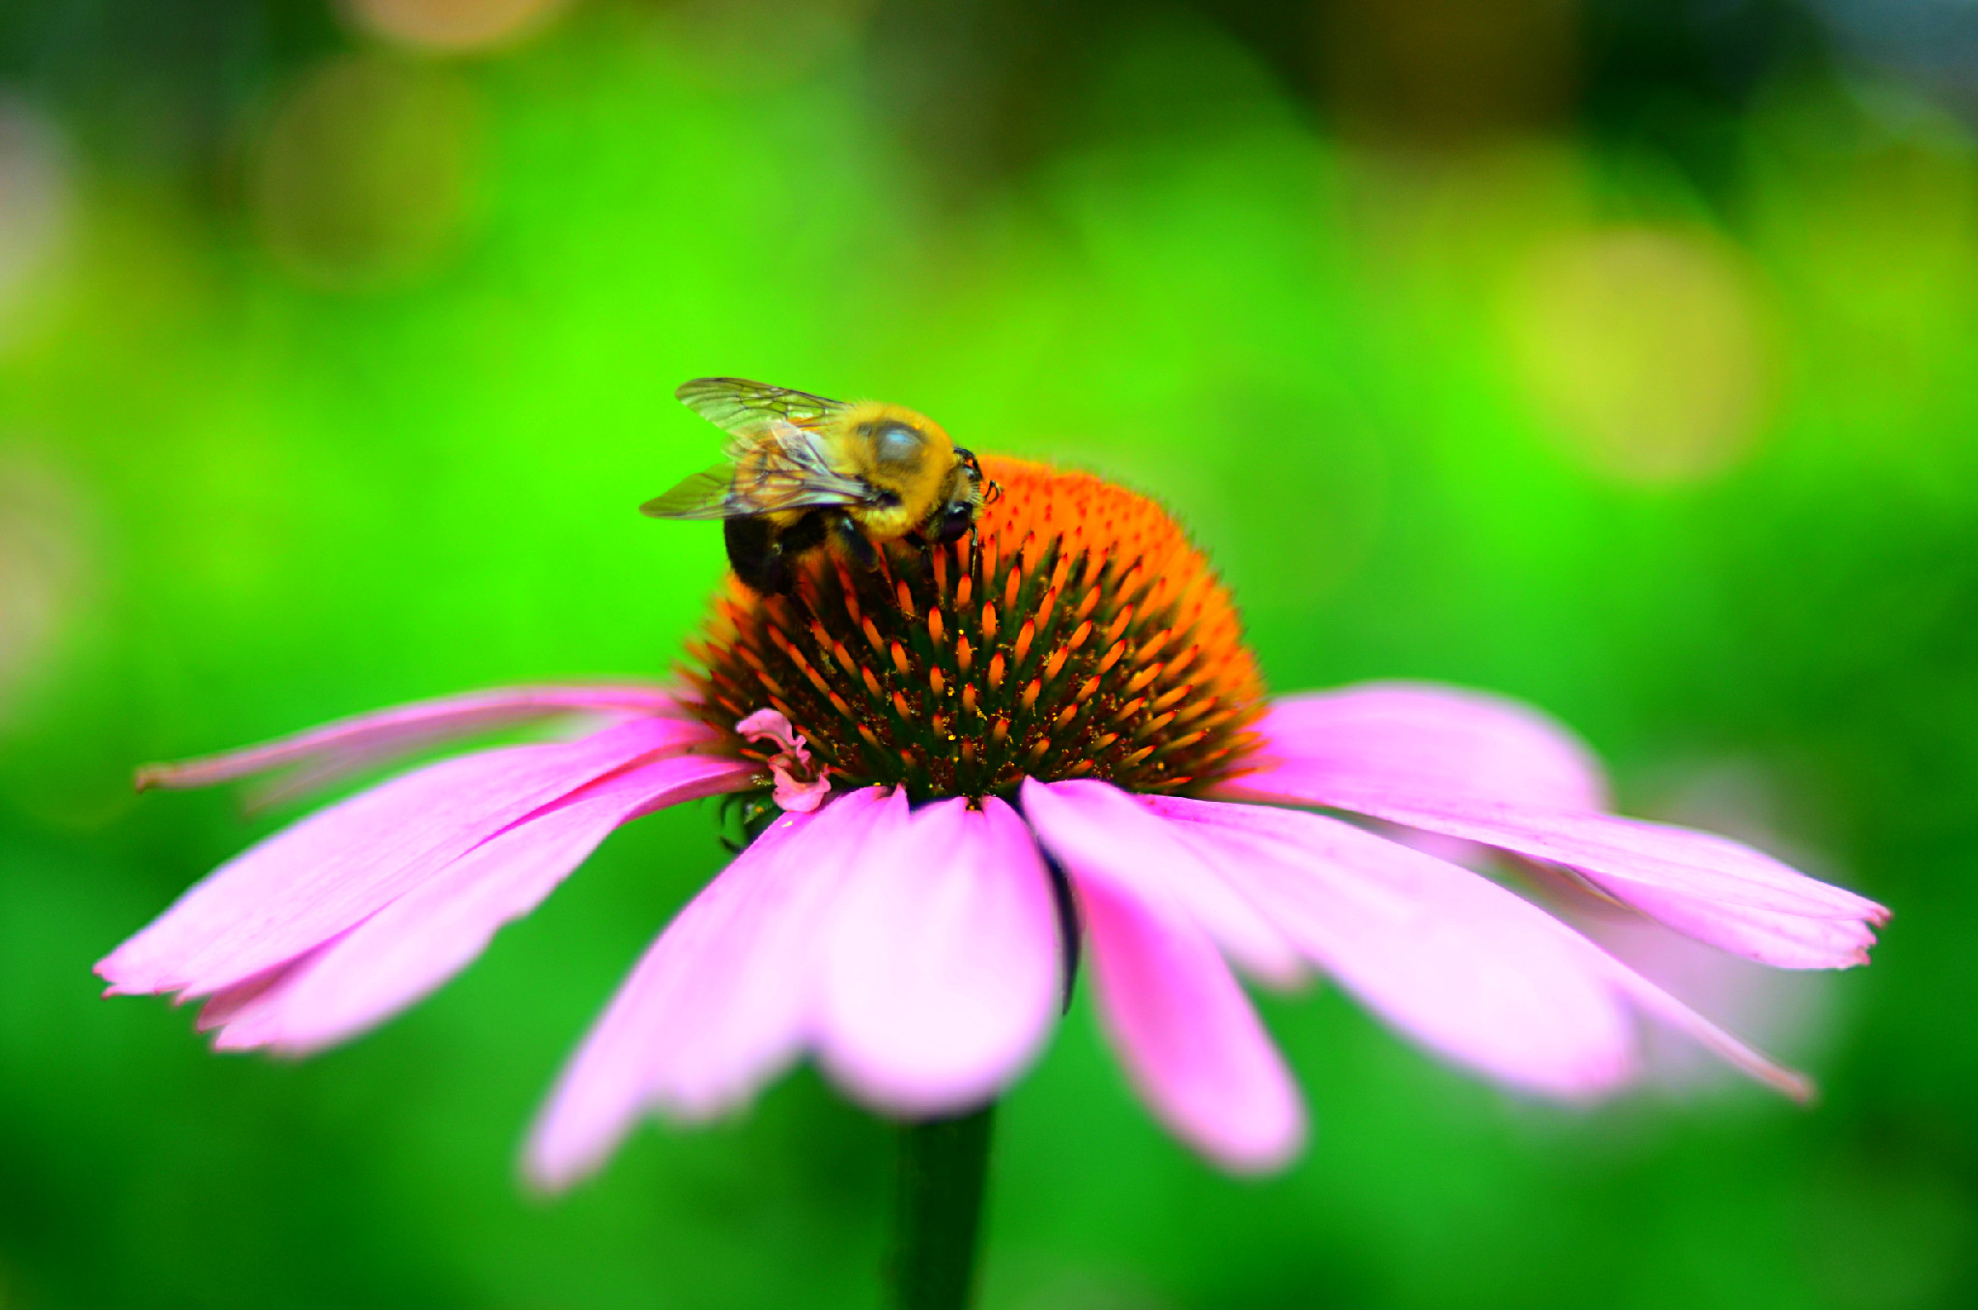
1
What Can You Do about It?
Protect Natural Habitats
Transform developed areas by planting a diverse range of pollinator plant species.
Avoid buying pesticides containing neonicotinoids or plants that have been treated with them.
Go completely pesticide free! Look into natural alternatives you can make from ingredients already in your kitchen, such as cooking oil and dish soap.

Slide 4
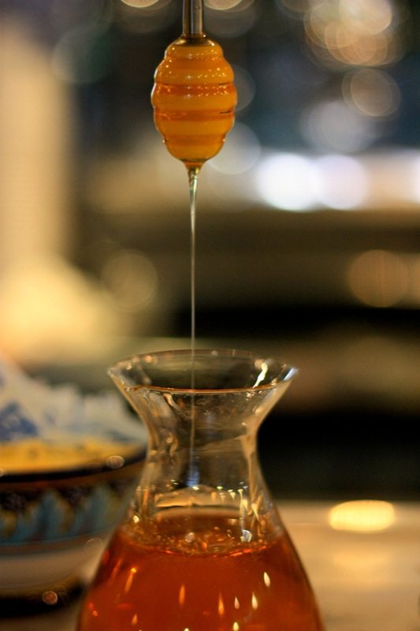
2
What Can You Do about It?
Buy local
Support and get to know your local beekeepers by buying local honey products.
Visit the Oregon Ridge Honey Harvest Festival, which takes place each fall. Here, local beekeepers come for demonstrations, craft activities, and local honey product sales.

Slide 5
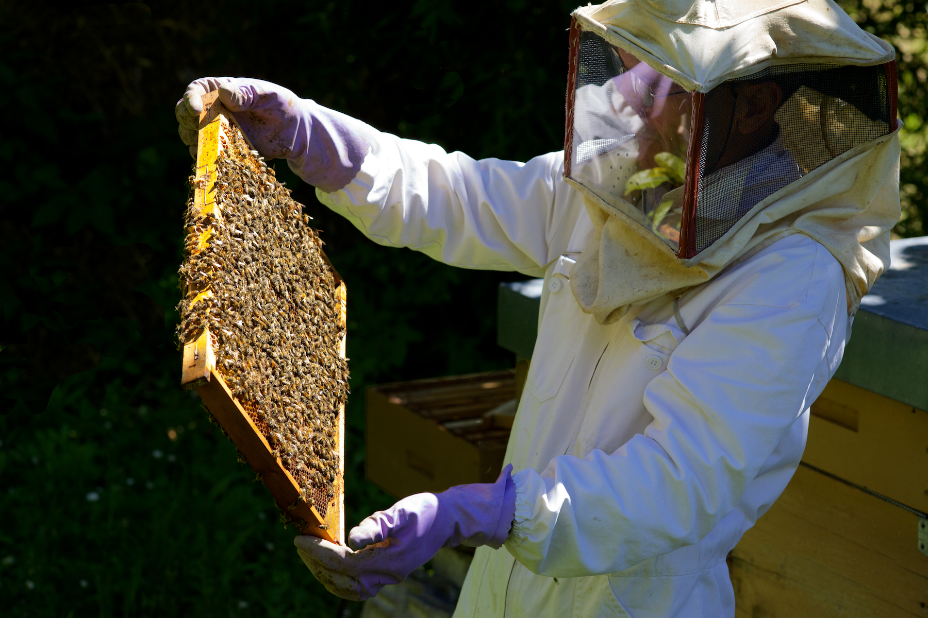
3
What Can You Do about It?
Do It Yourself
Become a backyard beekeeper.
Contact the American Beekeeping Federation or your local beekeeping club to get started.
Alternatively, you can donate to organizations working to save bees and other pollinators!

Slide 6
Credits
All photos used under Creative Commons licenses:
https://creativecommons.org/licenses/by-nc-sa/2.0/legalcode
“Deceased Bee” by Bryan Guilas via flickr.com (cropped)
“Honey I’m Home” by Kaytee Riek via flickr.com
https://creativecommons.org/licenses/by/2.0/legalcode
“Grapes On the Vine” by Ron Watts via flickr.com © Ron Watts / CORBIS
https://creativecommons.org/licenses/by-nc/2.0/legalcode
“Bumble Bee and the Flower” by Will Marlow via flickr.com
https://creativecommons.org/licenses/by-nc-nd/2.0/legalcode
“The Beekeeper” by mbeo via flickr.com (cropped)

